Slide 1
PARTERNO UREĐENJE JAVNIIH OTVORENIH PROSTORA - primeri dobre prakse -
Katedra za urbanizam i prostorno planiranje
Urbanizam IV

Slide 2
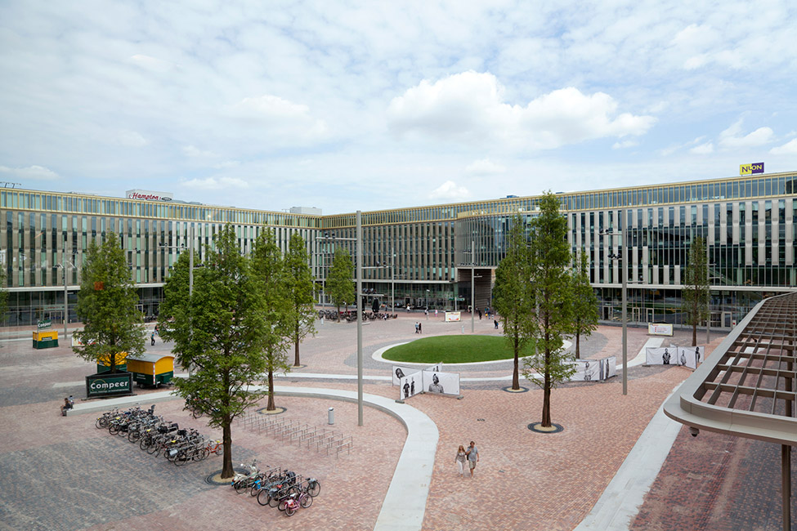
Hoekenrode Square, Amsterdam, The Netherlands Izvor:http://landezine.com/index.php/2014/08/hoekenrode-square-by-karres-en-brands/

Slide 3
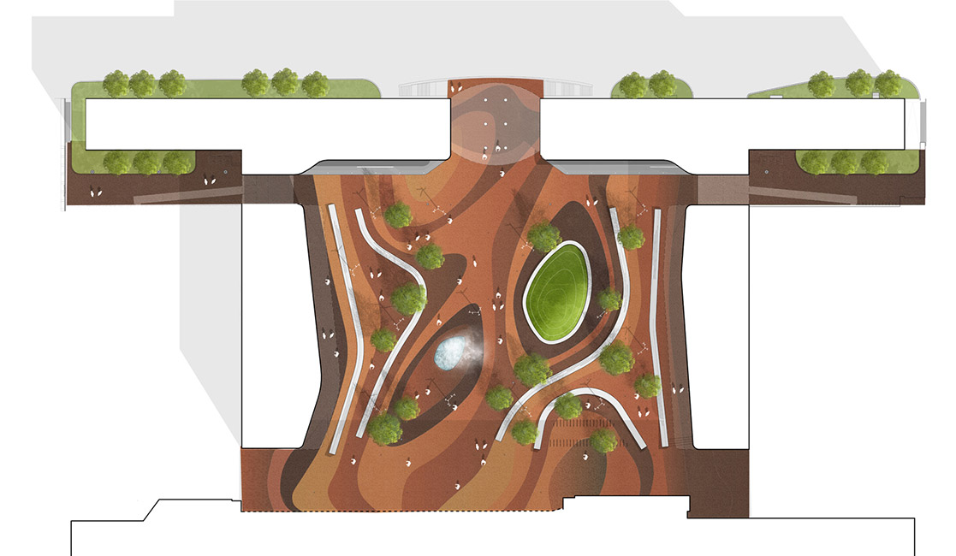

Slide 4
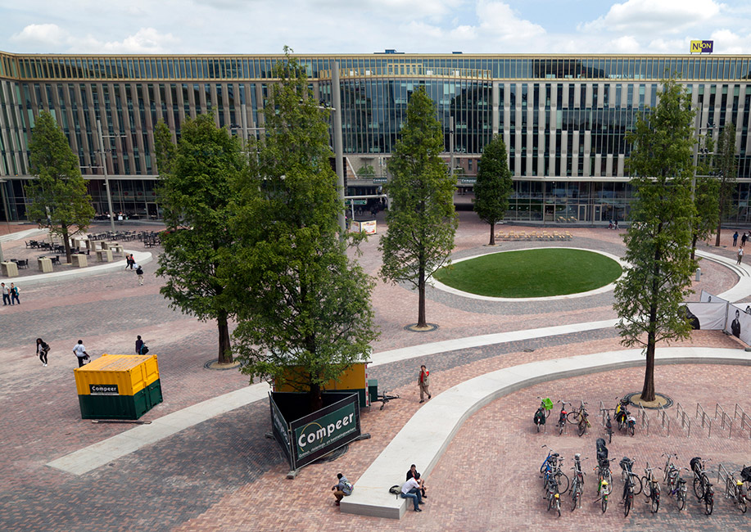

Slide 5
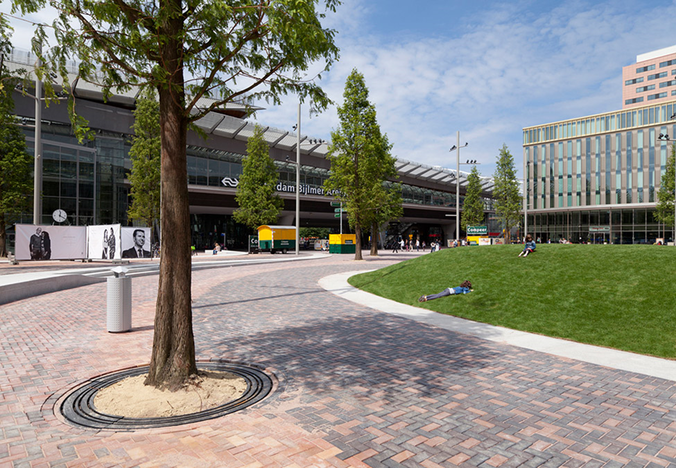

Slide 6
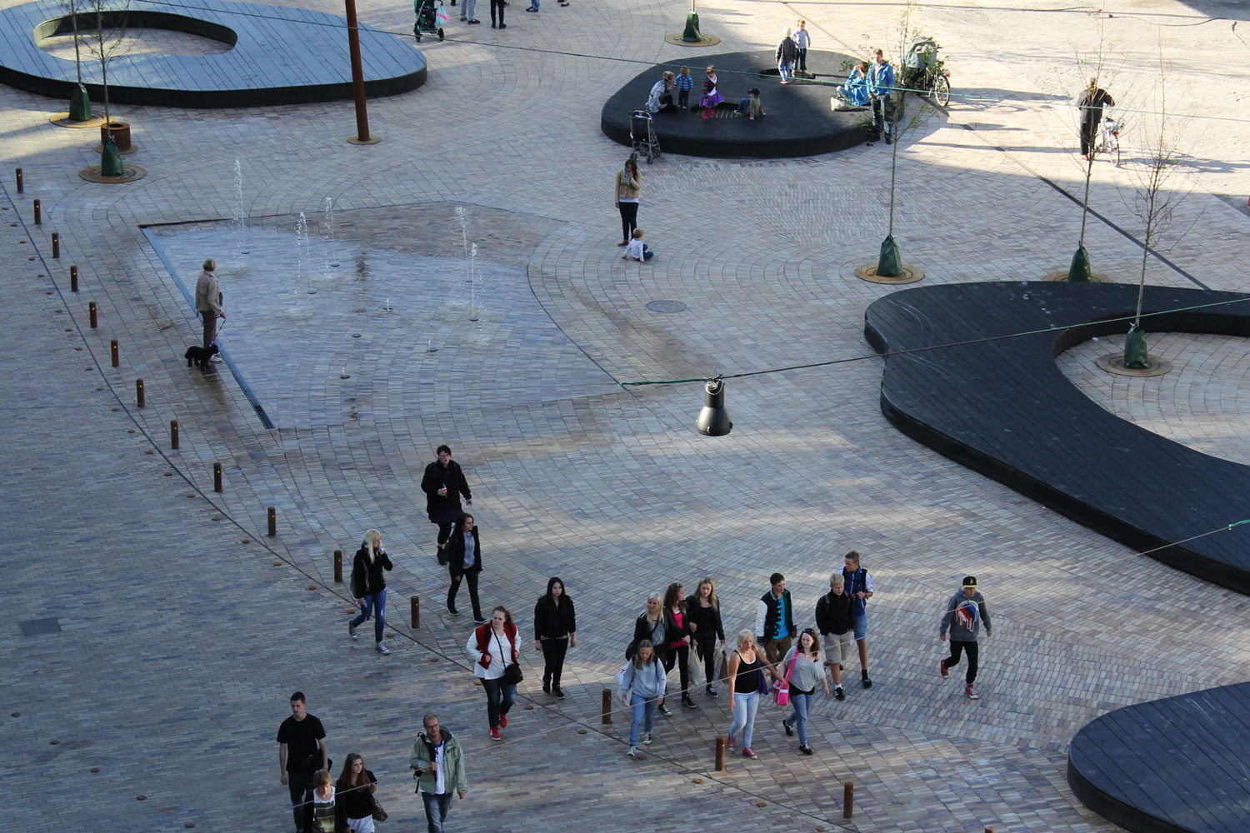
Grønnegade Square, Odense, Denmark Izvor:http://landezine.com/index.php/2019/07/gronnegade-square-by-masu-planning/

Slide 7
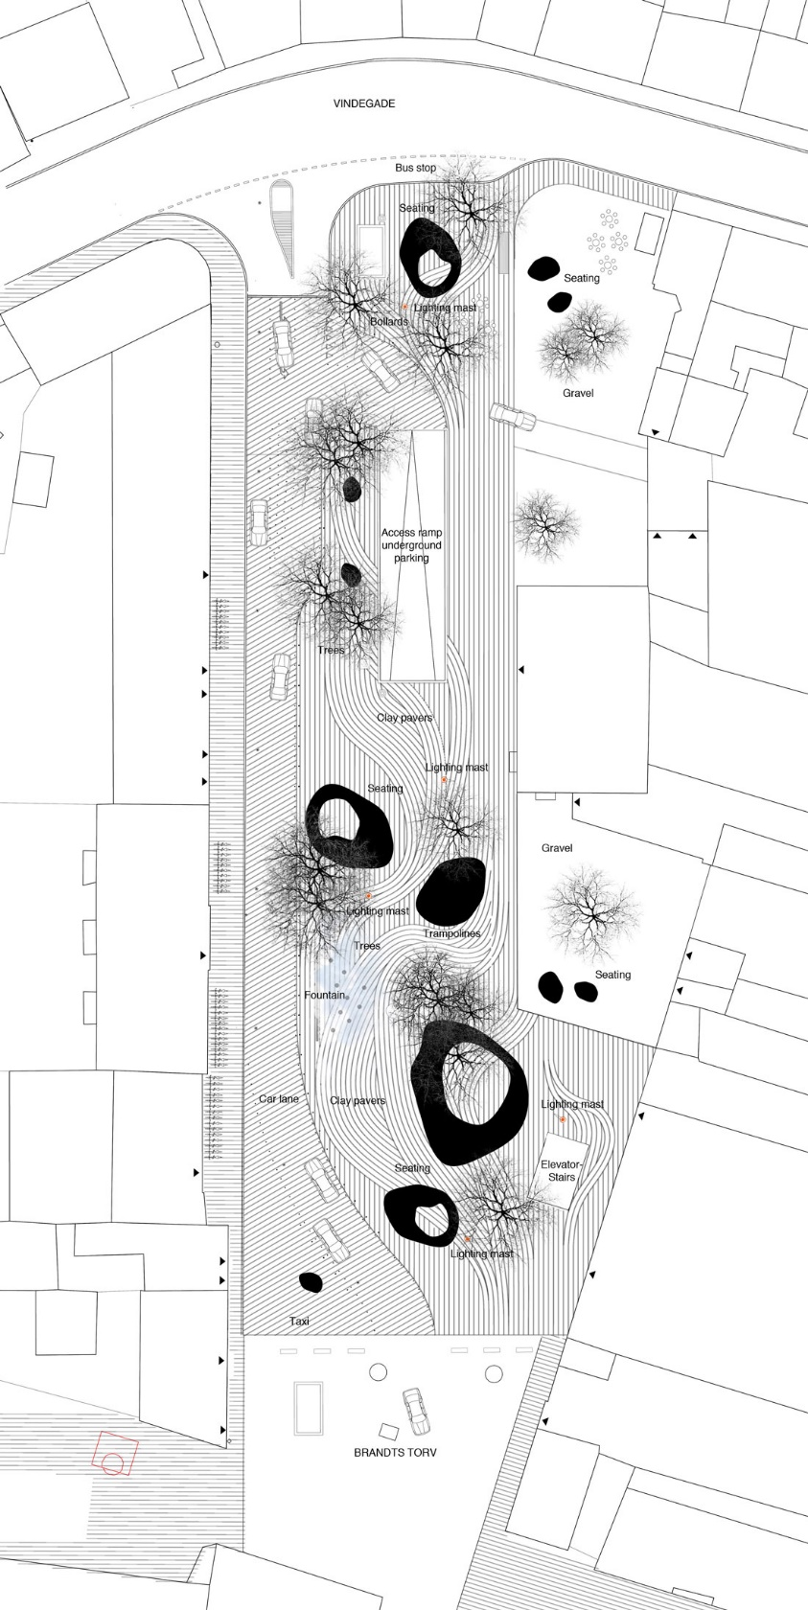
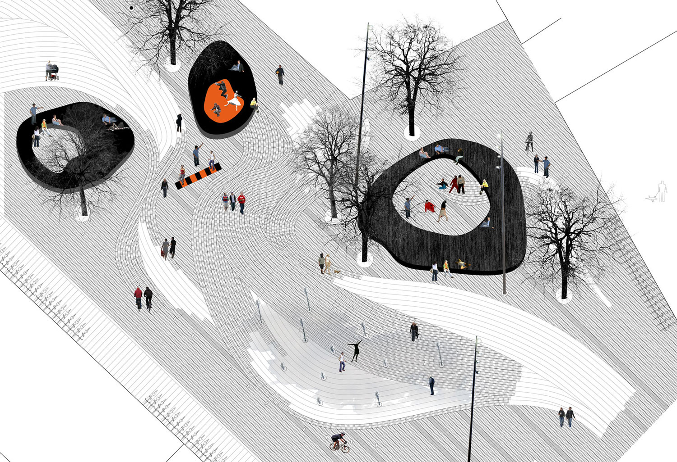

Slide 8
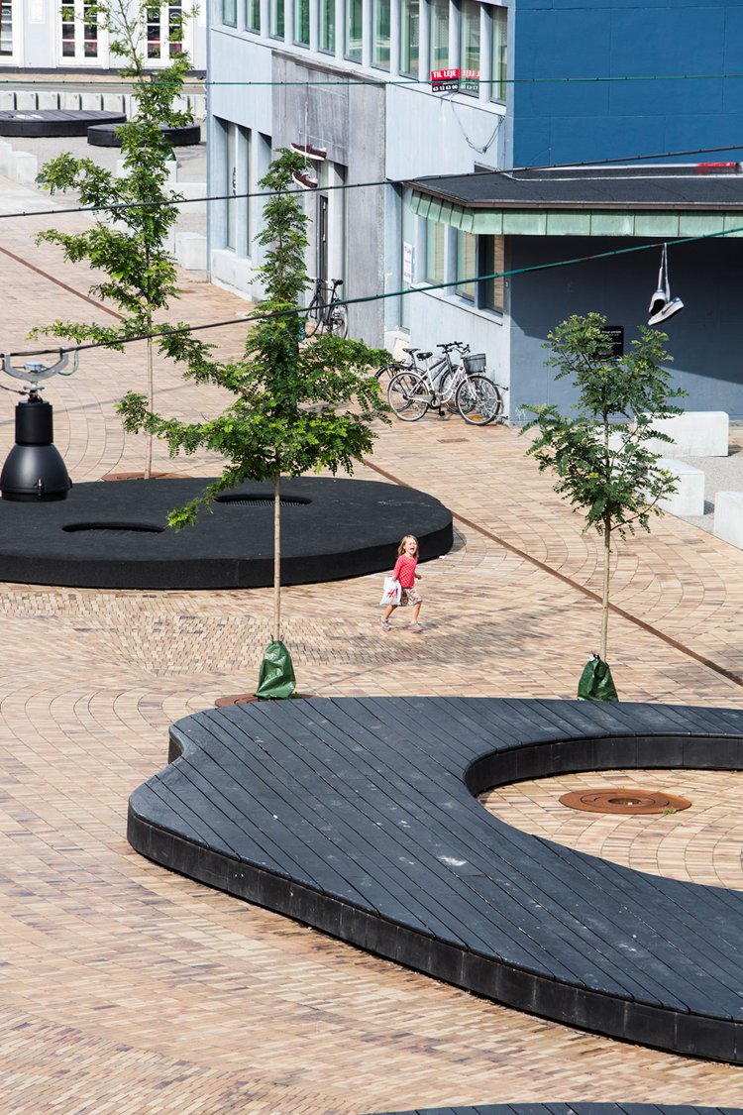
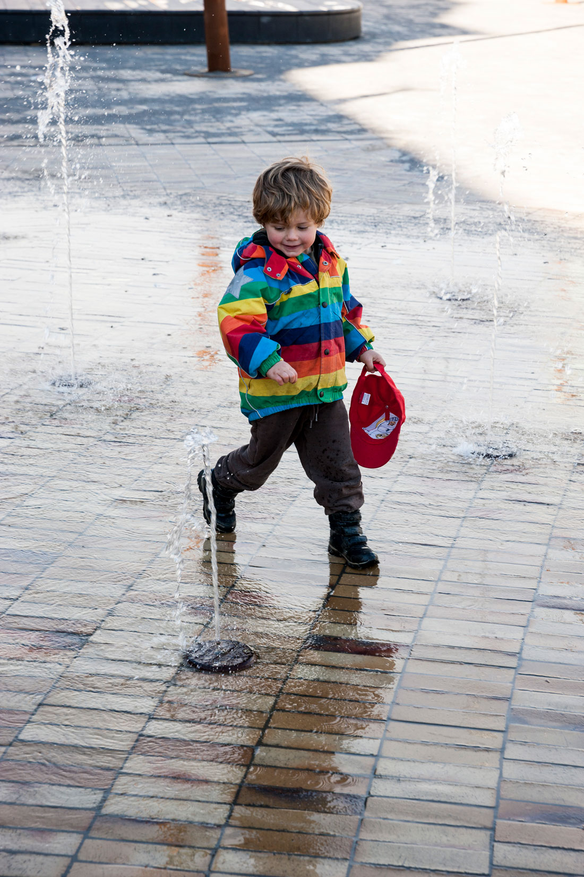

Slide 9
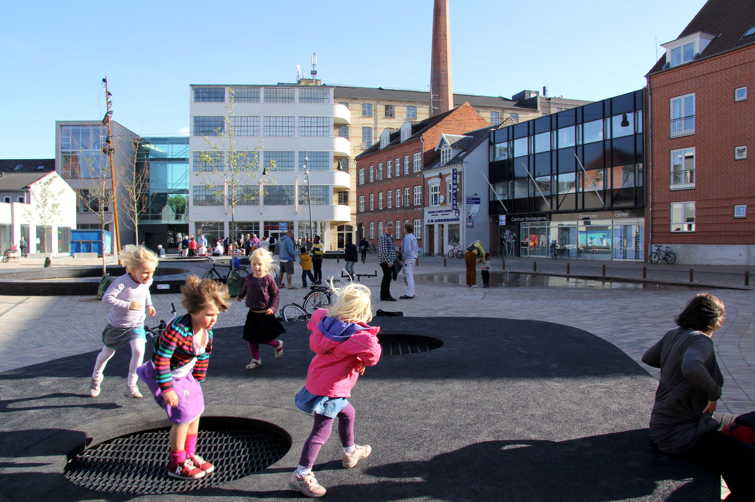

Slide 10
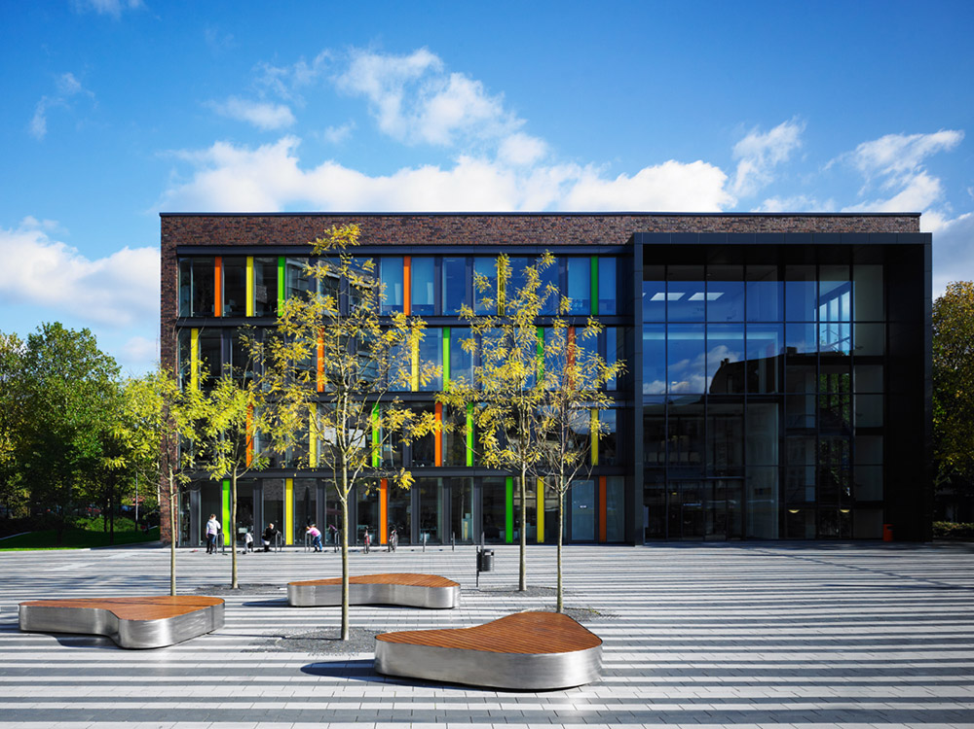
Town Hall Square Solingen, Germany Izvor:http://landezine.com/index.php/2012/05/town-hall-square-solingen- by-scape-landschaftsarchitekten/

Slide 11
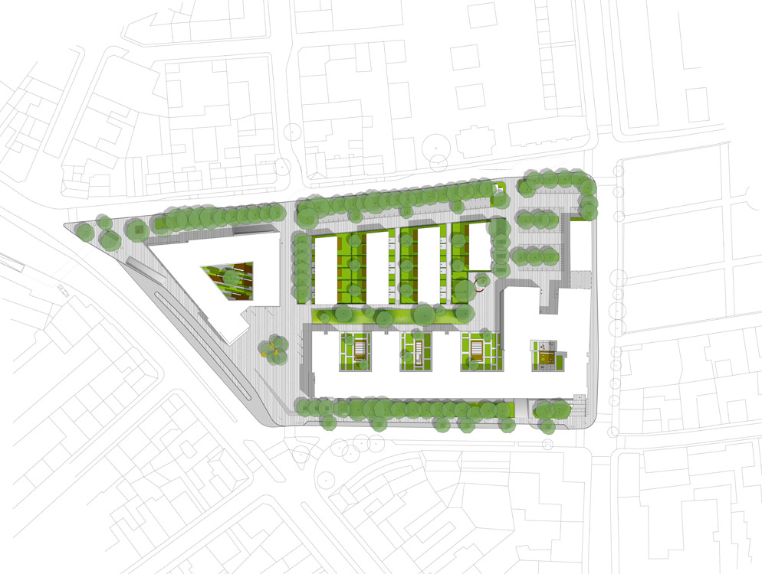

Slide 12
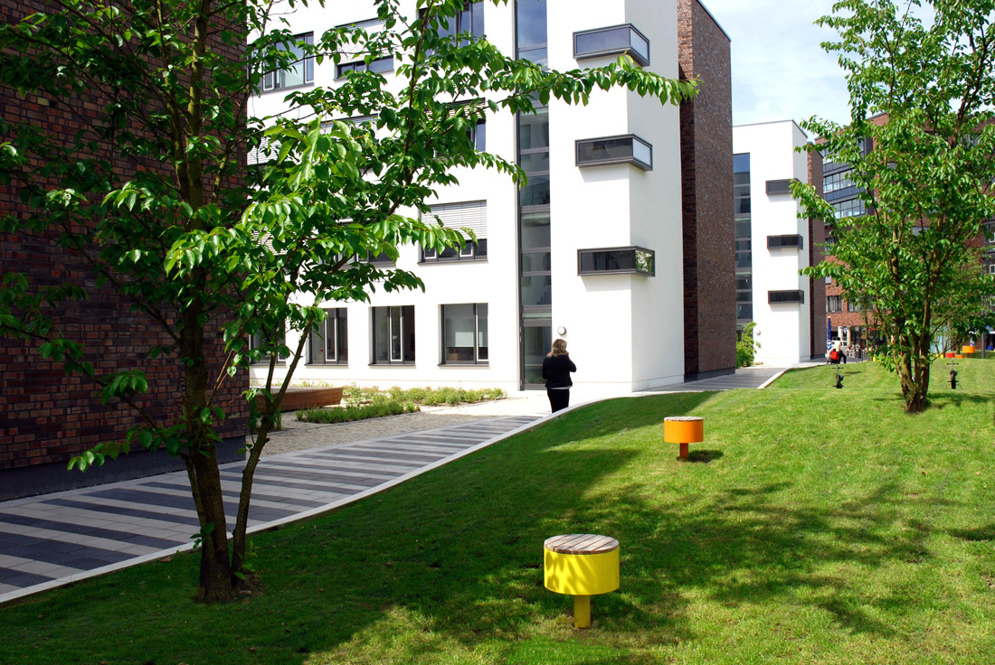

Slide 13
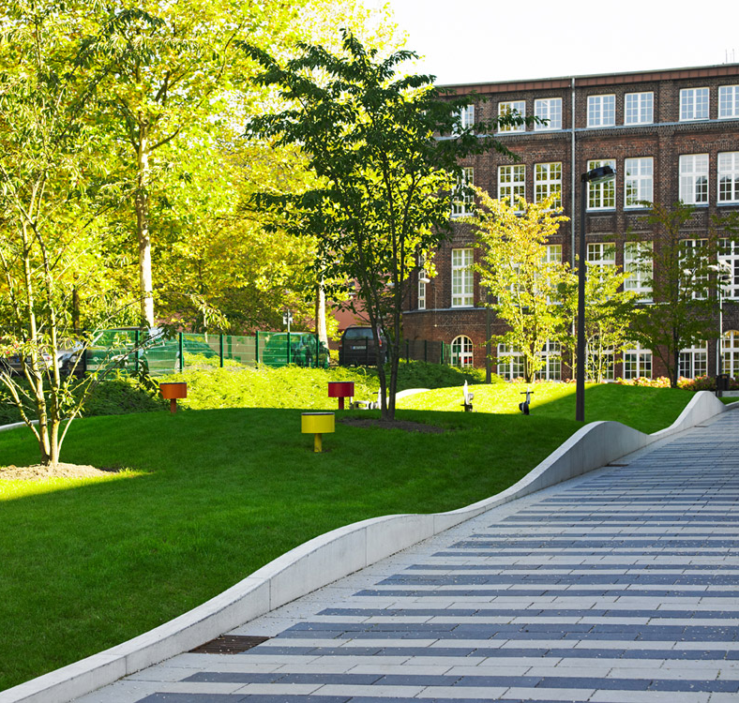
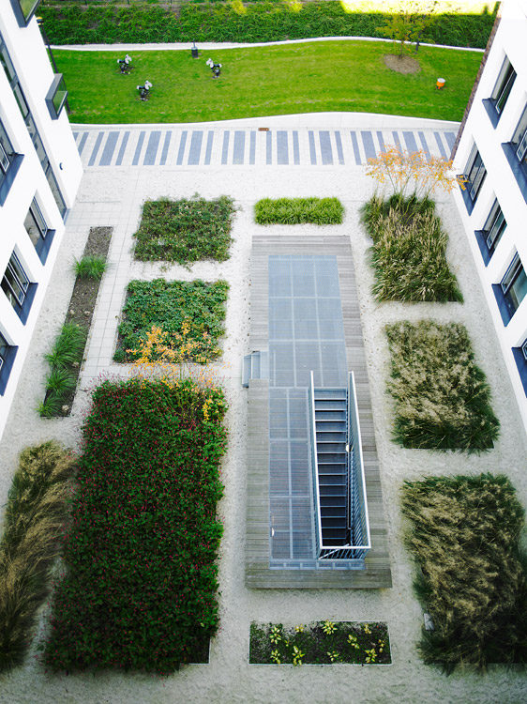

Slide 14
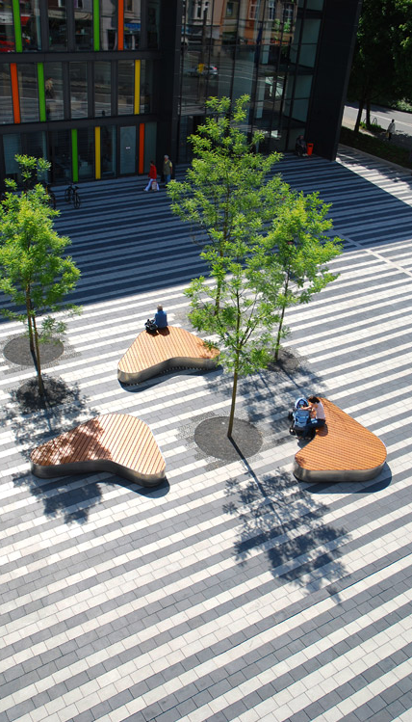
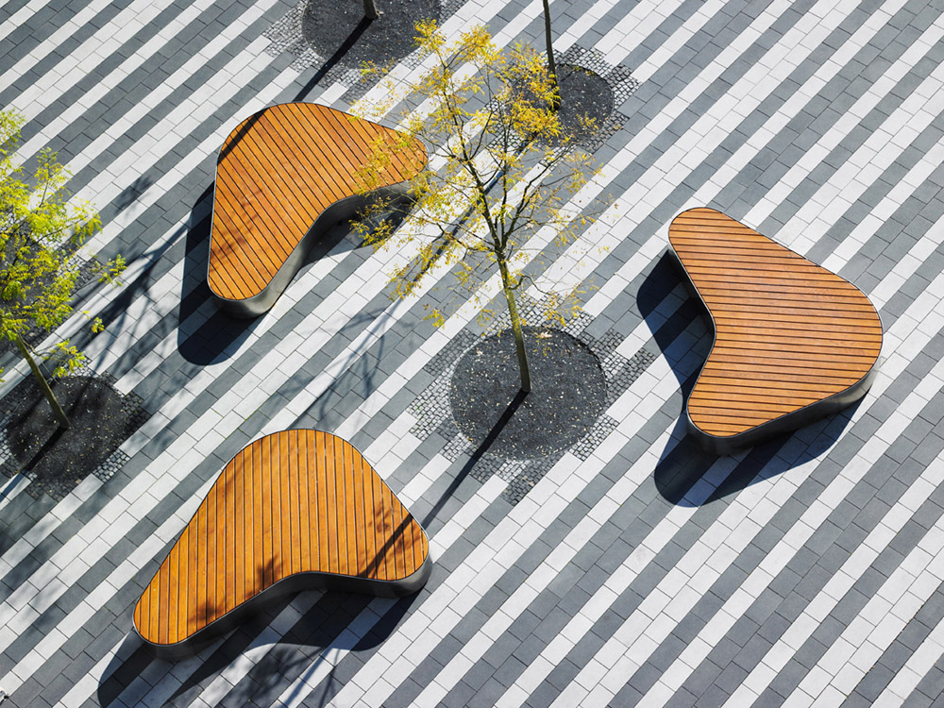

Slide 15
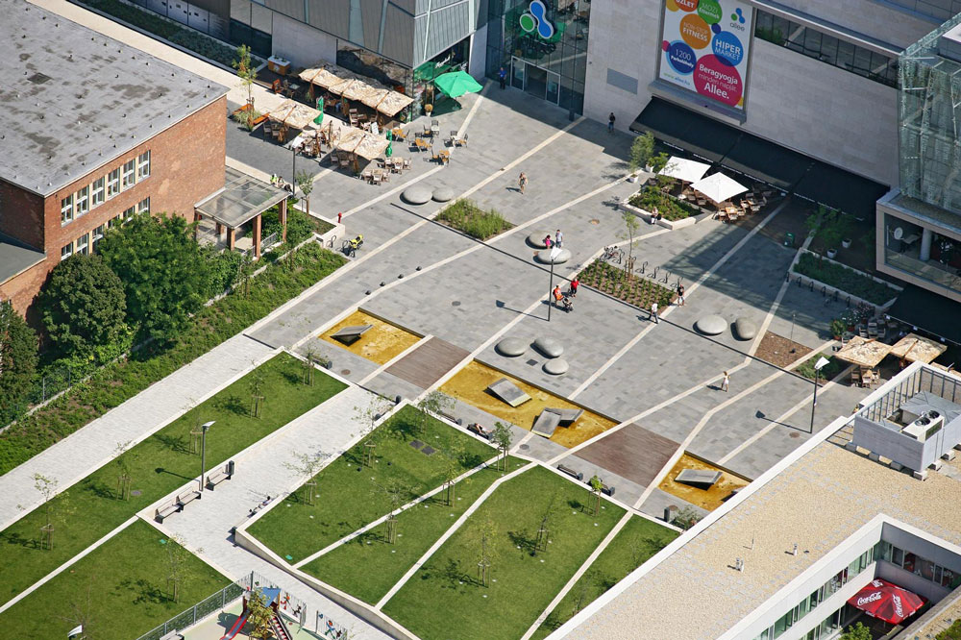
ÚJBUDA CITY CENTRE, BUDAPEST, HUNGARY Izvor:http://landezine.com/index.php/2011/01/ujbuda-city-centre-by-garten-studio/

Slide 16
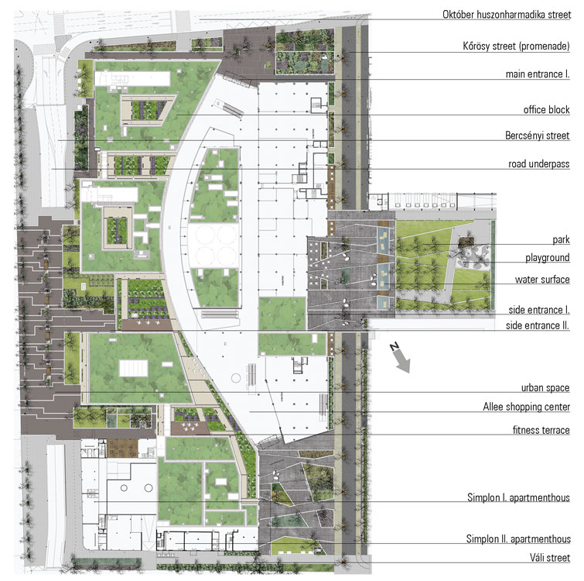
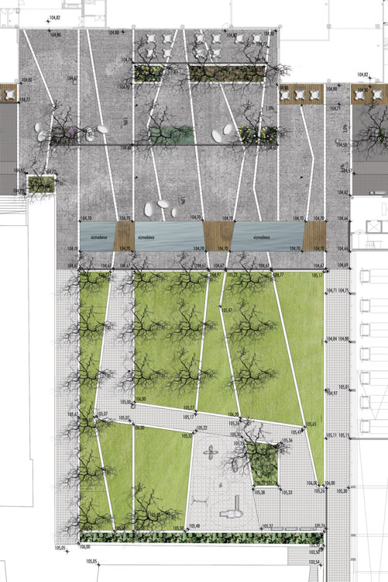

Slide 17
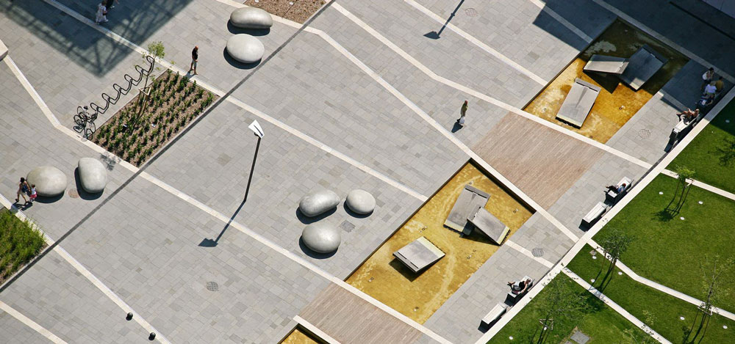

Slide 18
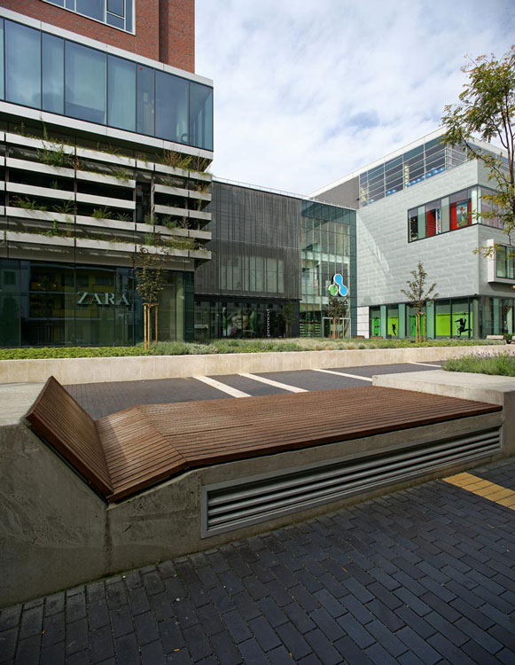
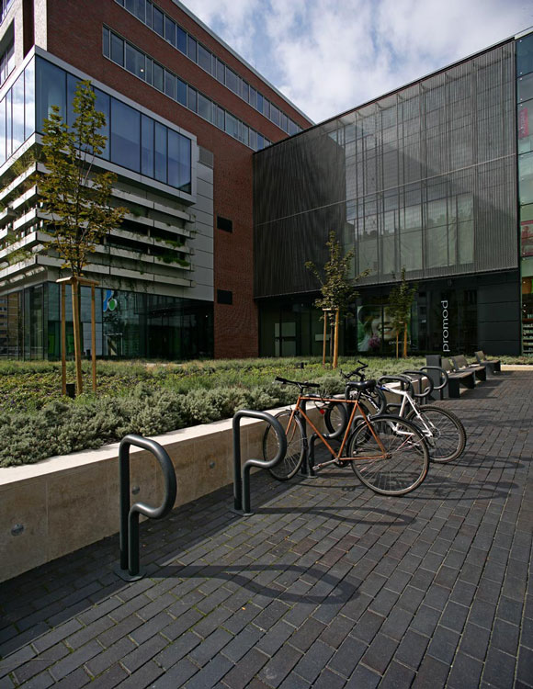

Slide 19
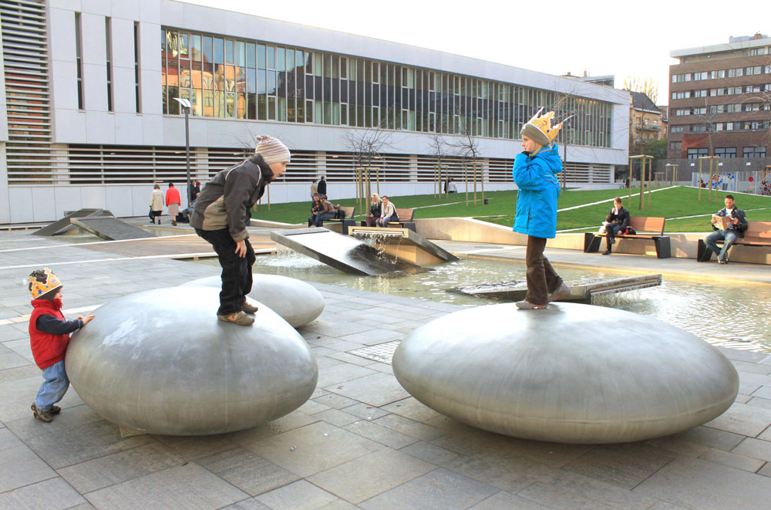

Slide 20
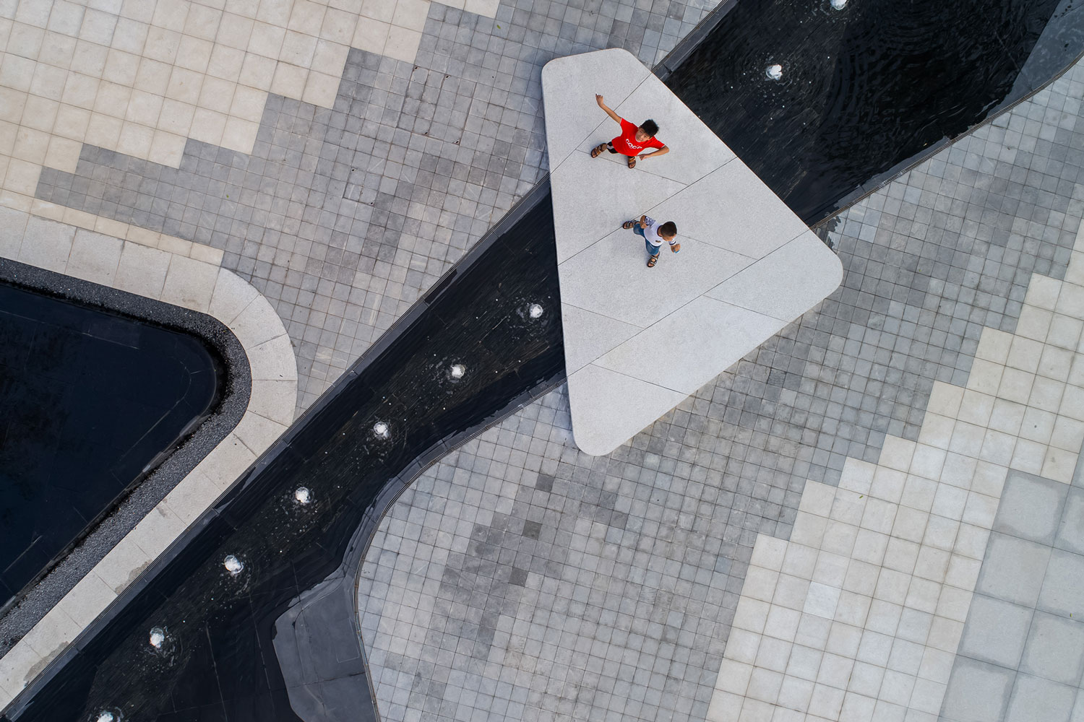
Xi’an Qingyue demonstration area, China Izvor:/http://landezine.com/index.php/2018/09/xian-qingyue- demonstration-area-by-waterlily-studio/

Slide 21
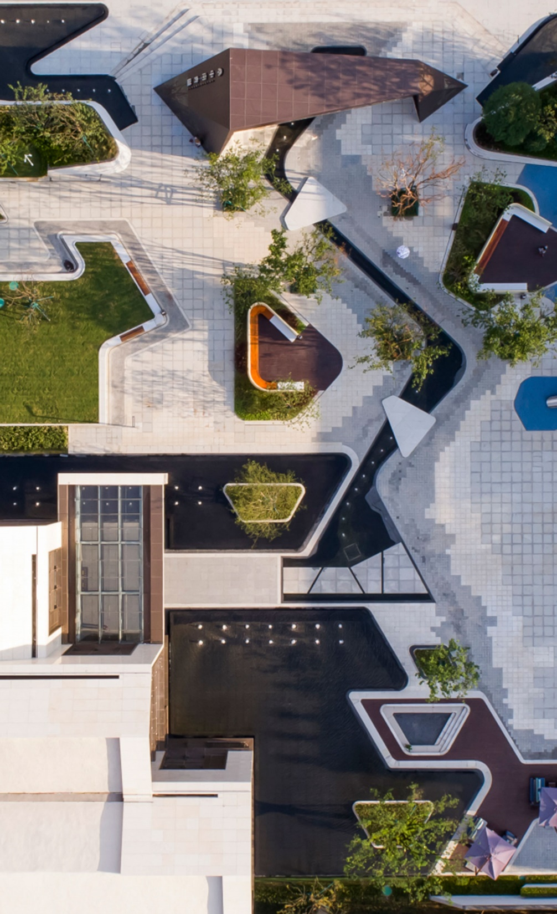
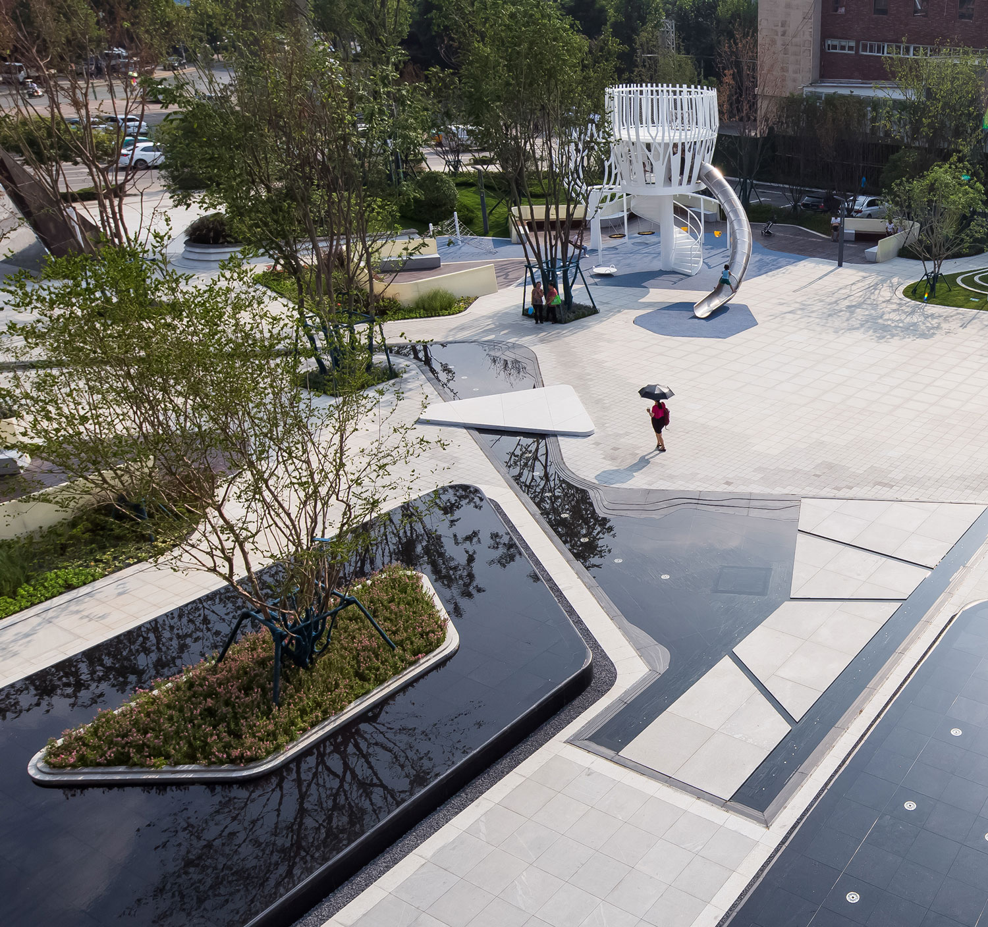

Slide 22
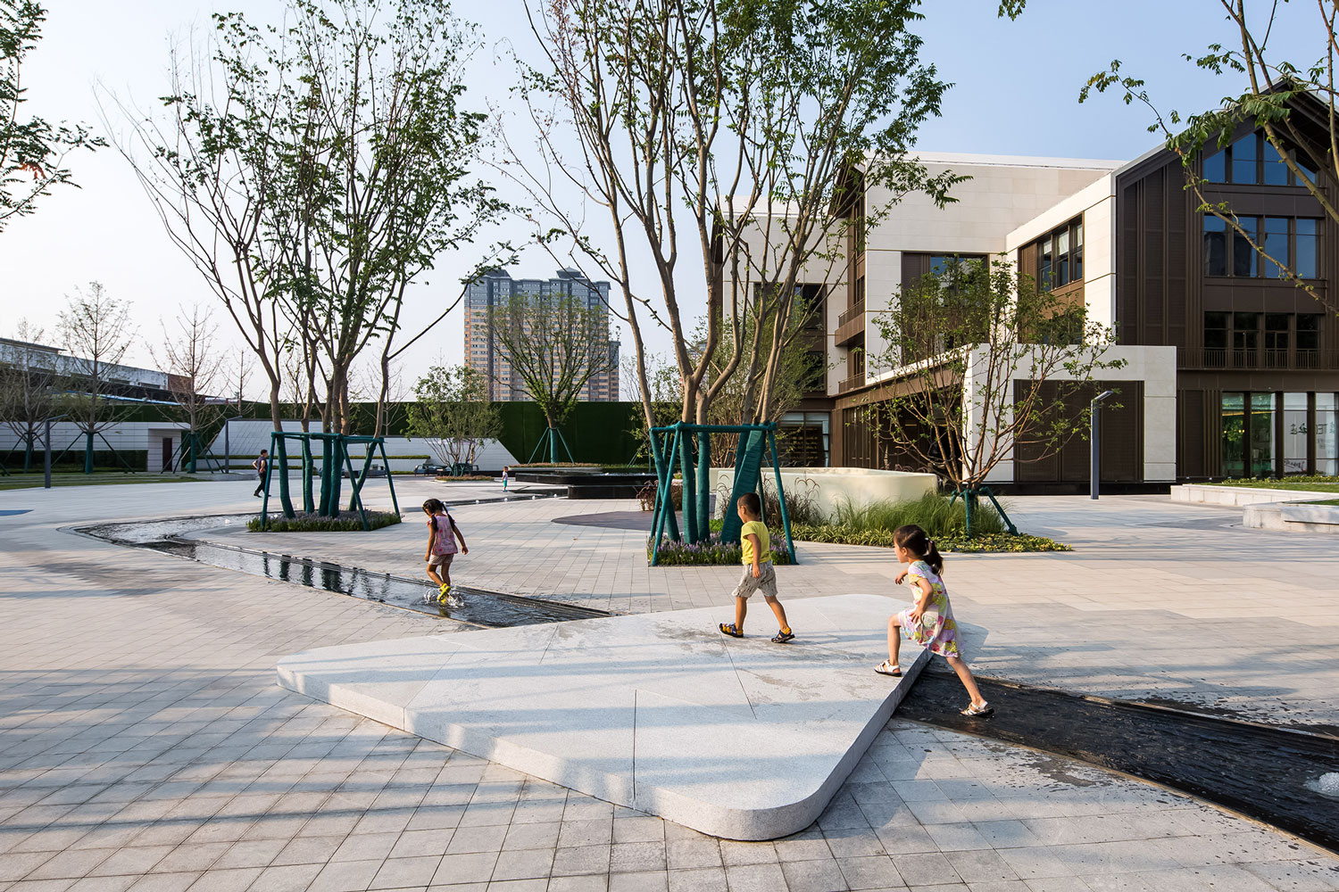

Slide 23
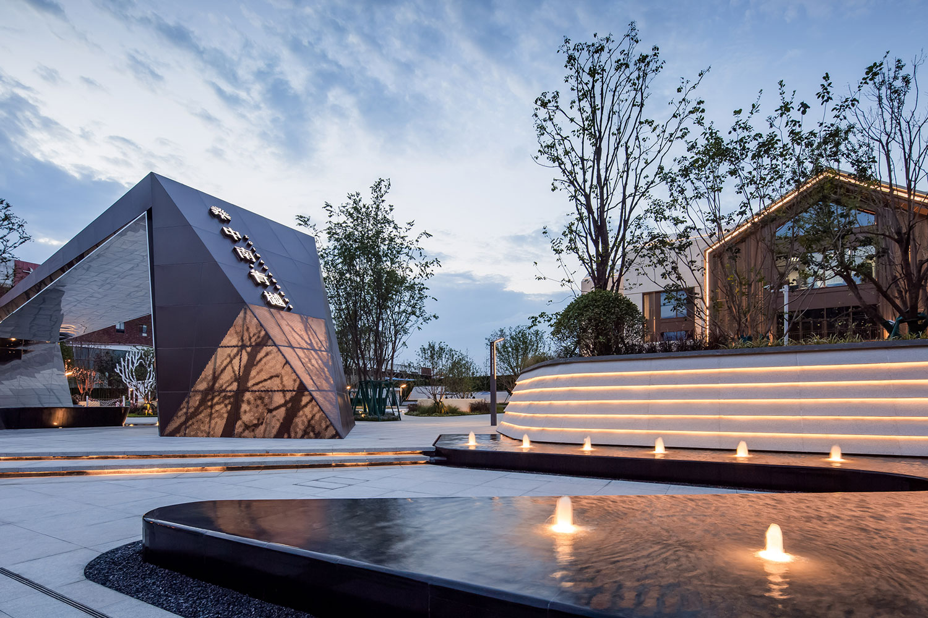

Slide 24
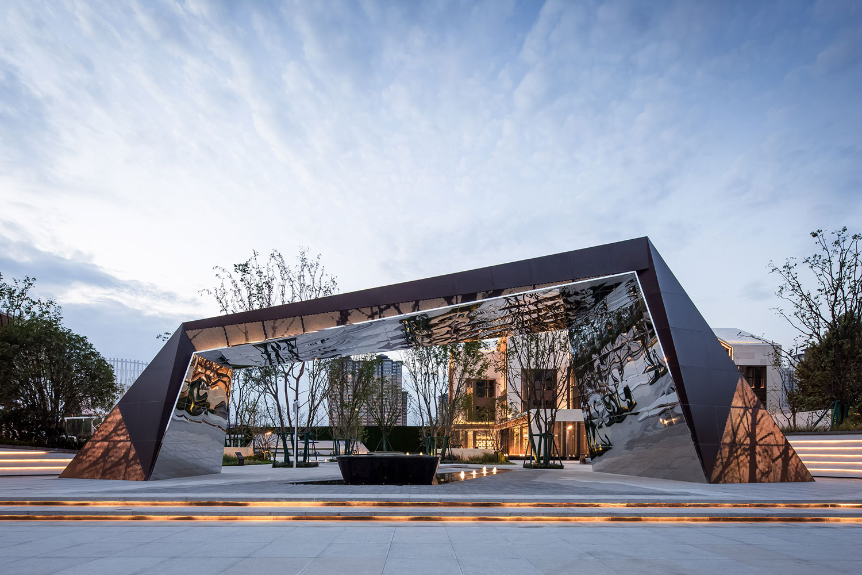

Slide 25
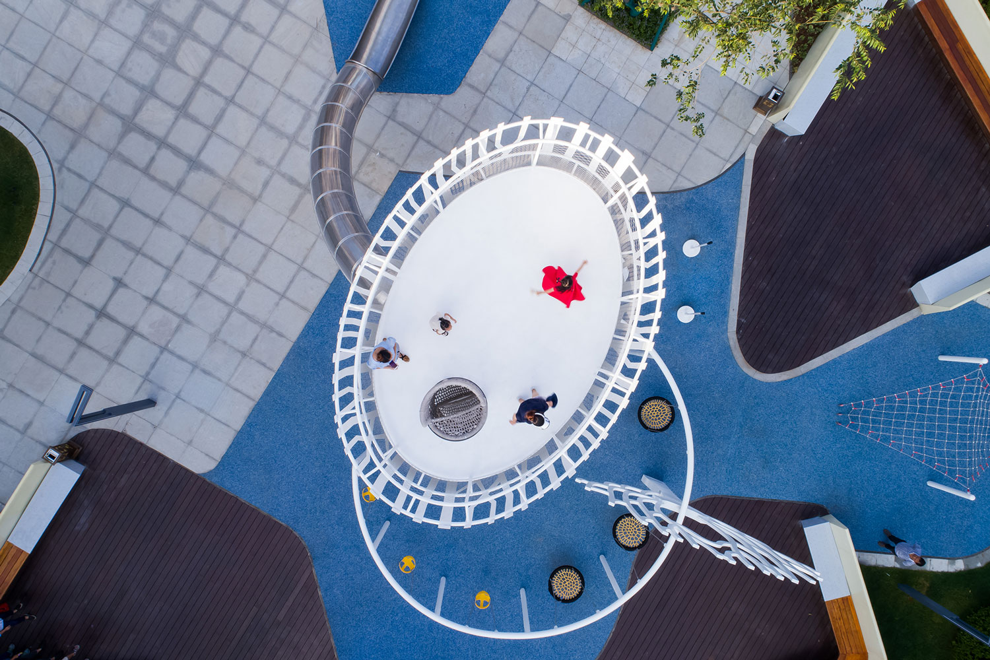
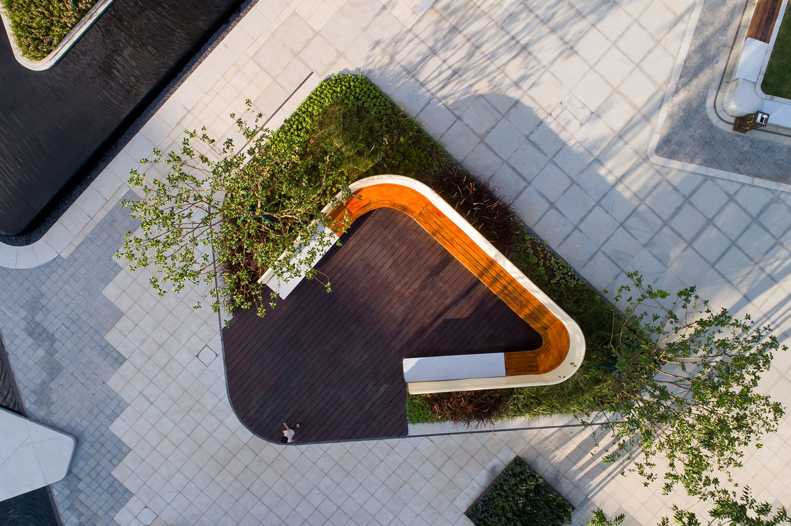

Slide 26
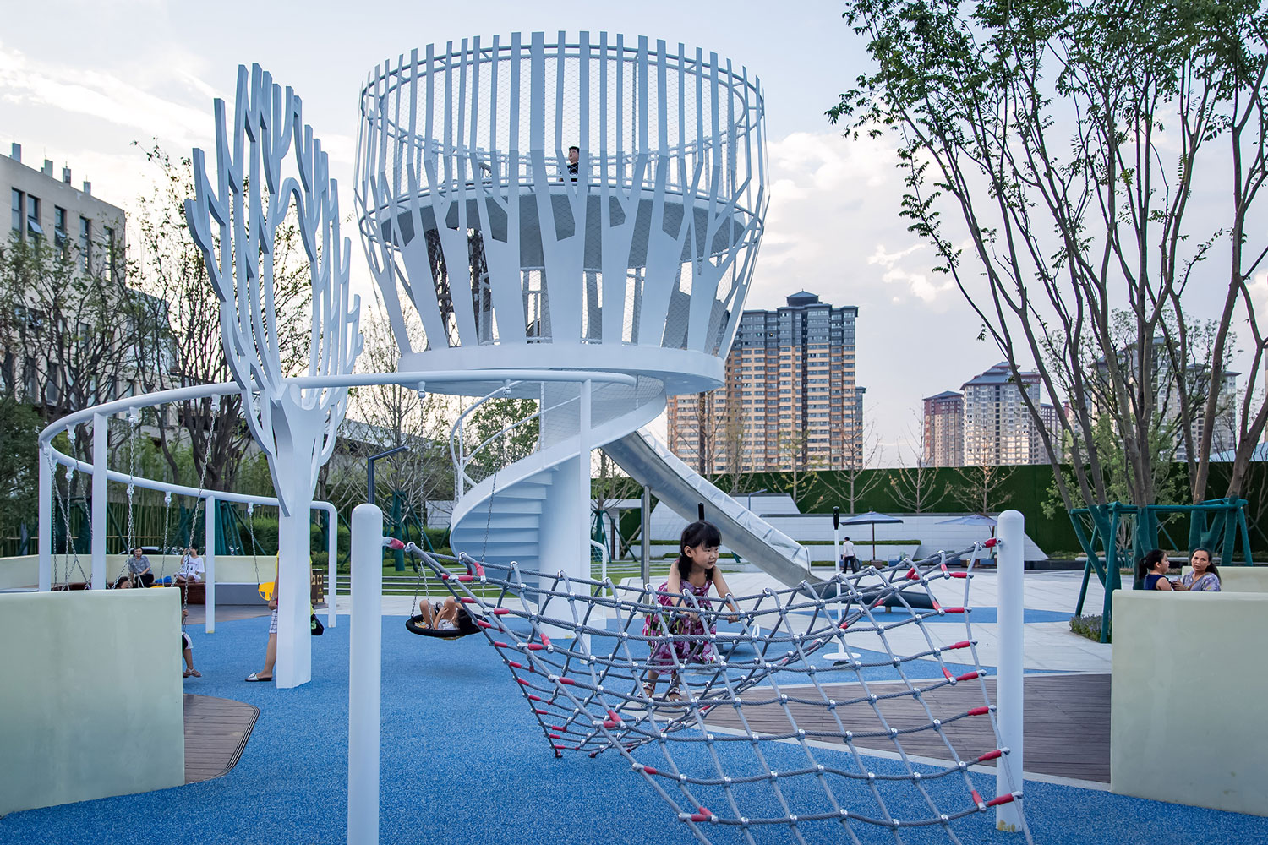

Slide 27
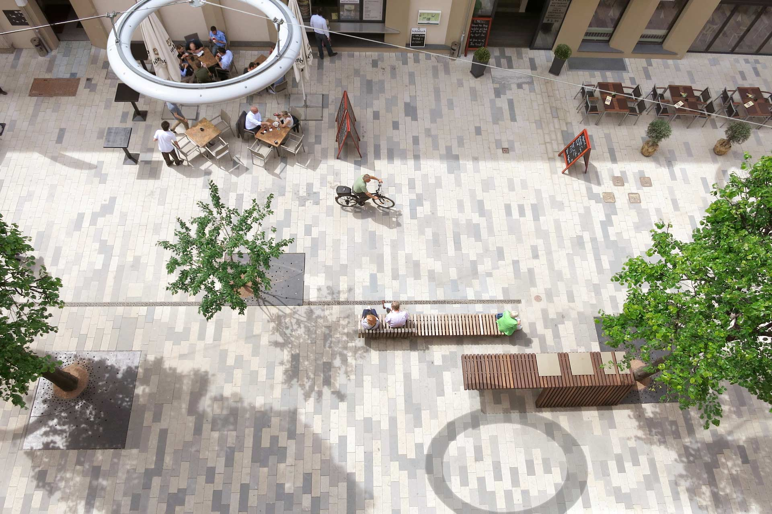
Hoekenrode Square, Amsterdam, The Netherlands https://landezine-award.com/neue-meile-bo%CC%88blingen/

Slide 28
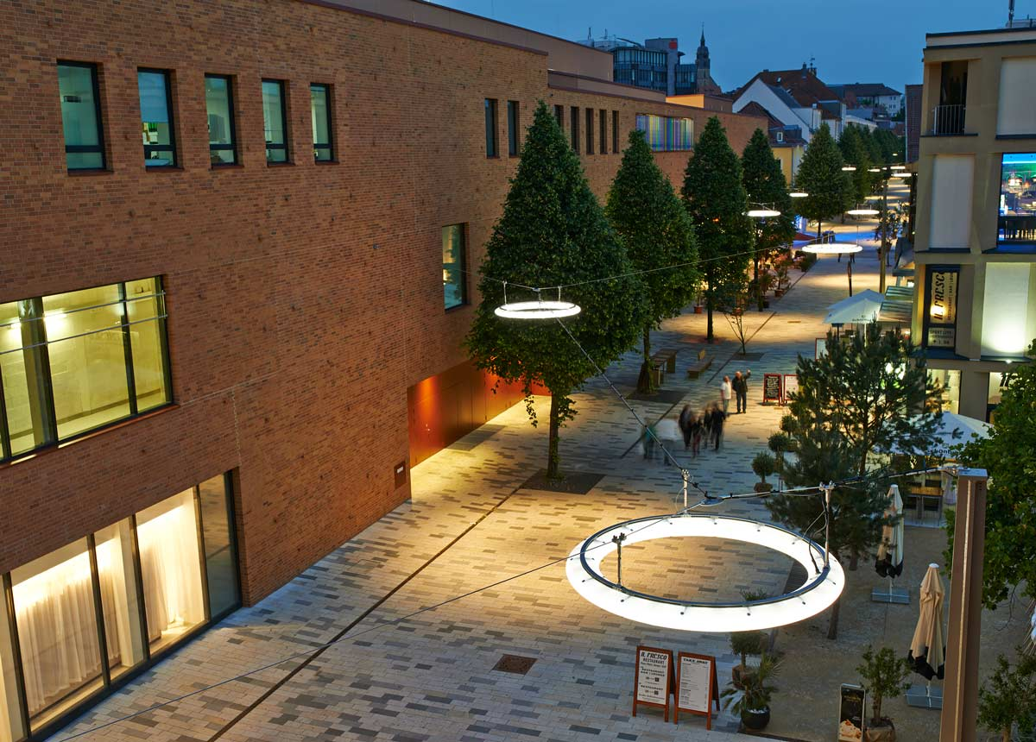
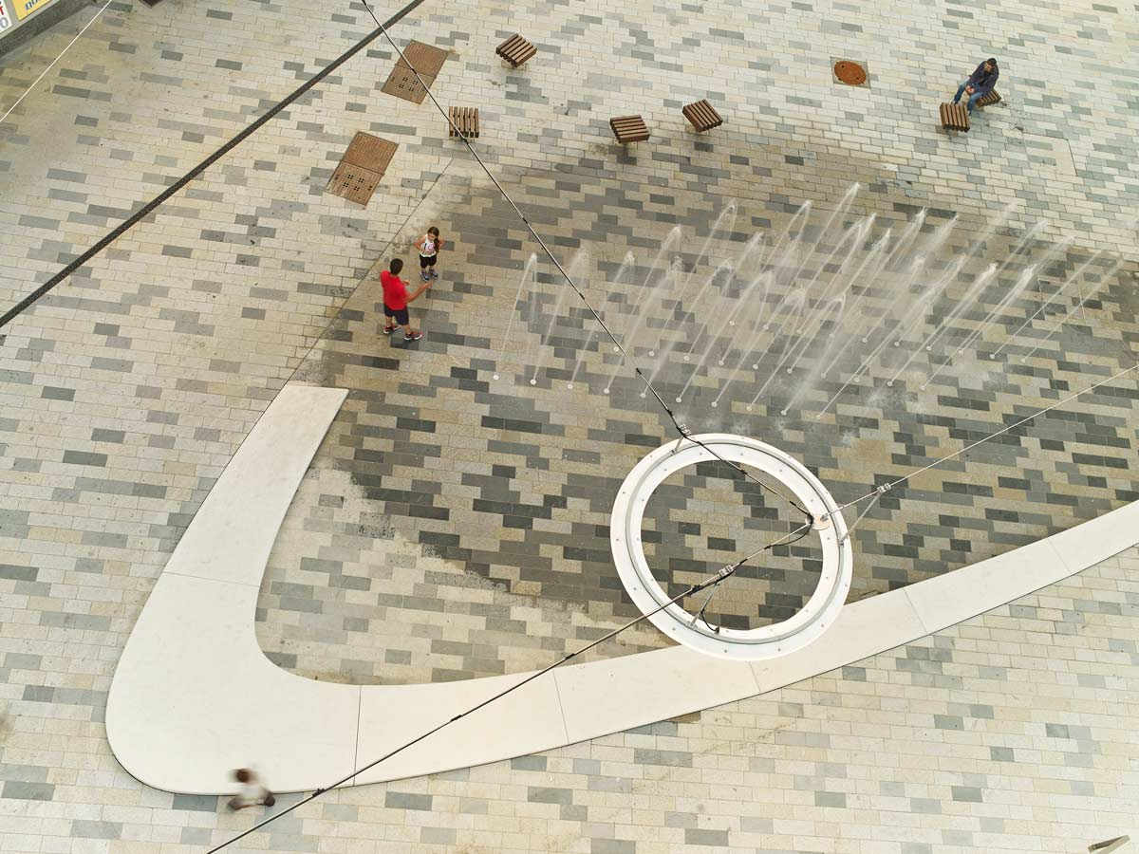

Slide 29
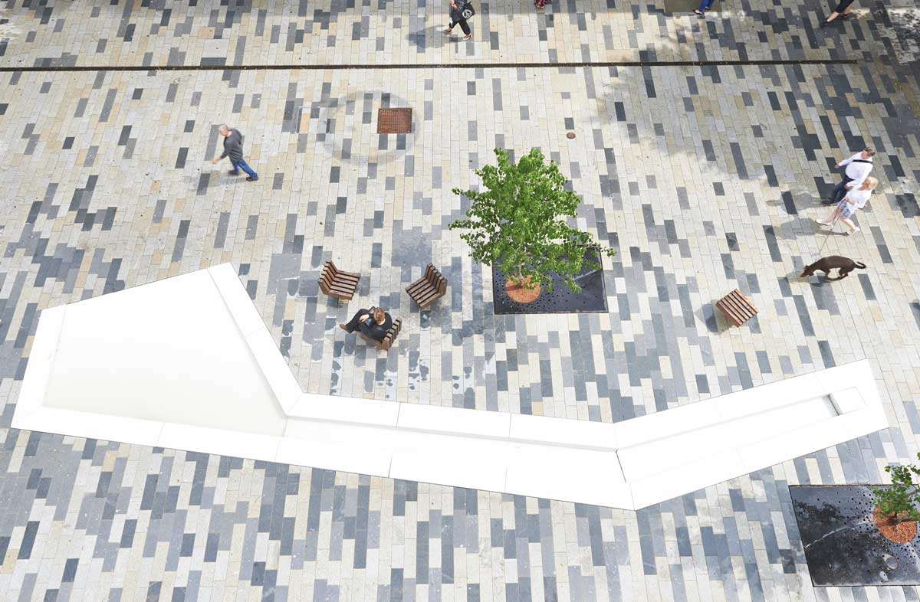
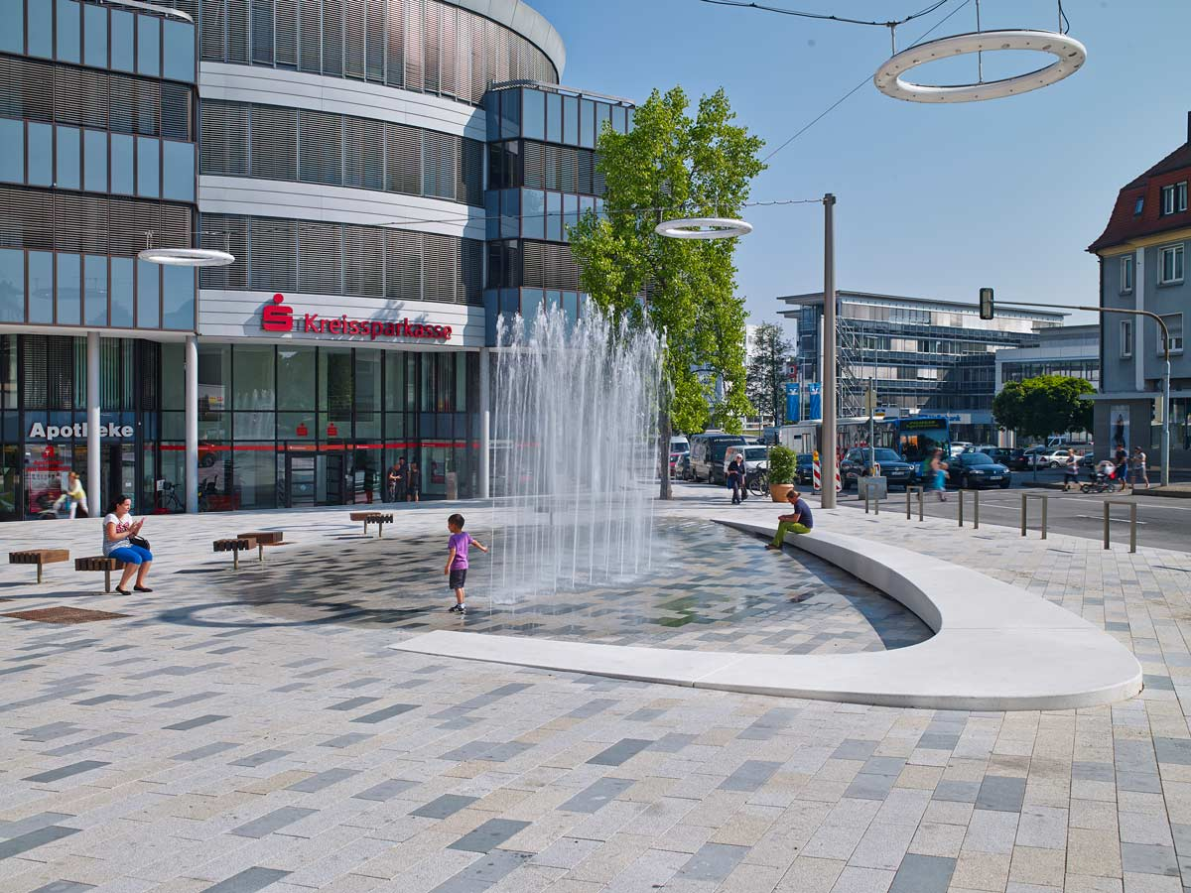
Notes:
bauchplan-pedestrian-zone

Slide 30
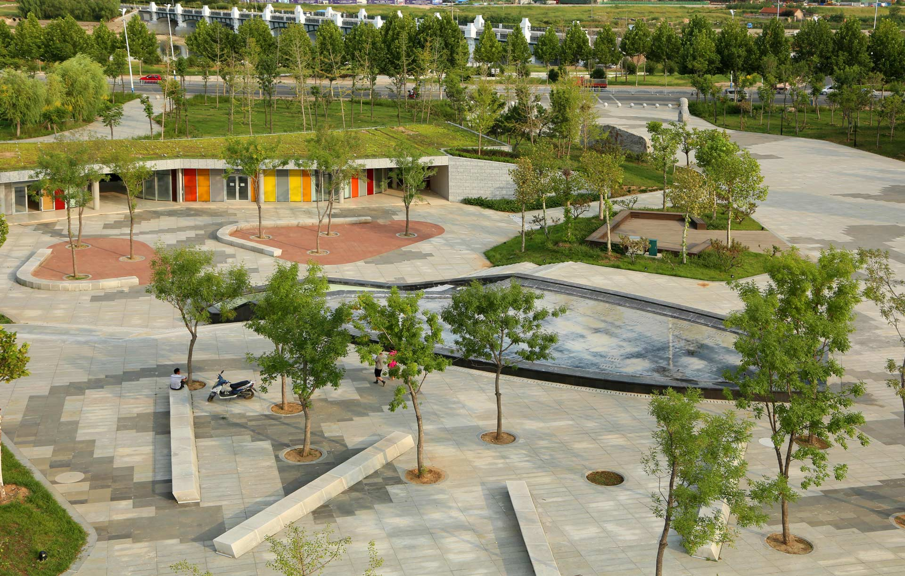
Qinglongshan Cultural Plaza
http://landezine.com/index.php/2016/03/qinglongshan-cultural-plaza-by-atelier-dyjg//

Slide 31
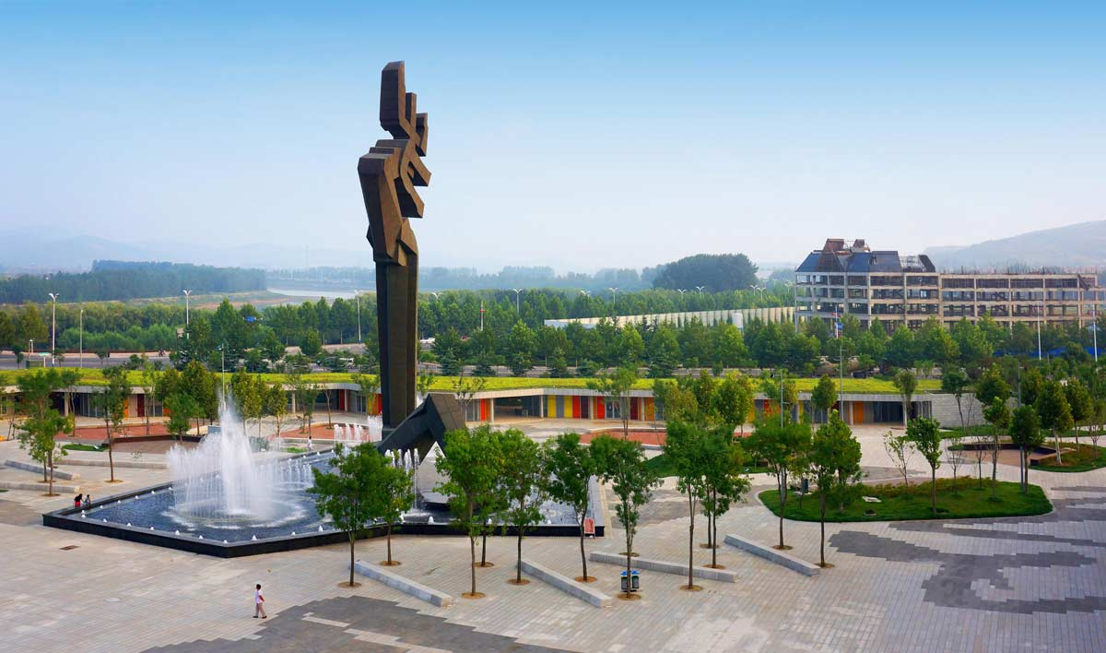
Notes:
Cultural-Plaza-Park

Slide 32
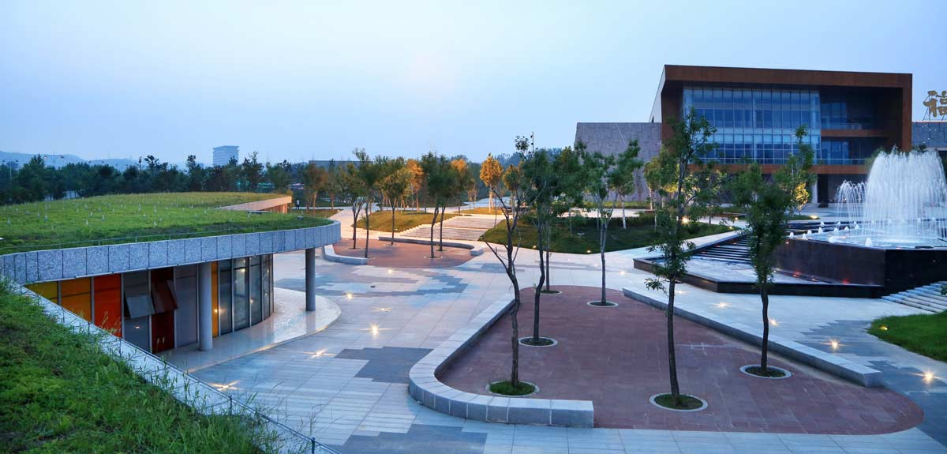

Slide 33
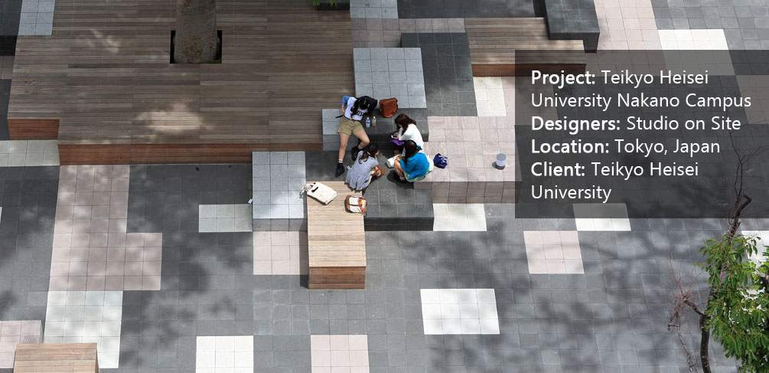
Teikyo Heisei University Nakano Campus
https://laud8.wordpress.com/reinterpreting-nature-in-design-teikyo-heisei-university-nakano-campus/

Slide 34
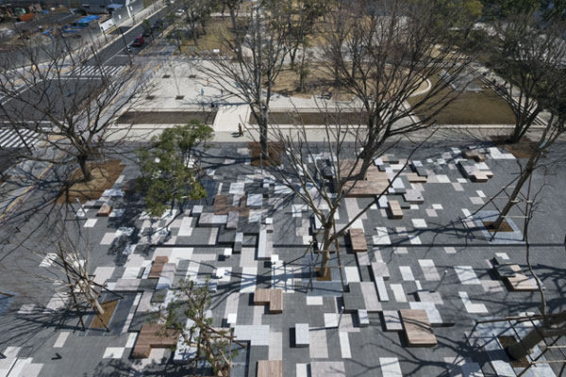

Slide 35
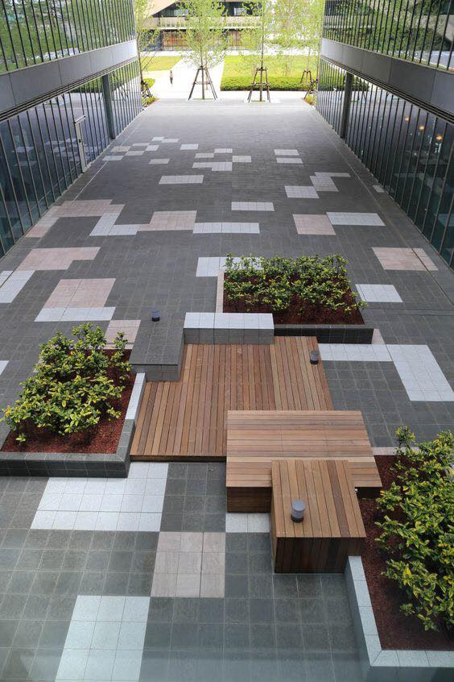
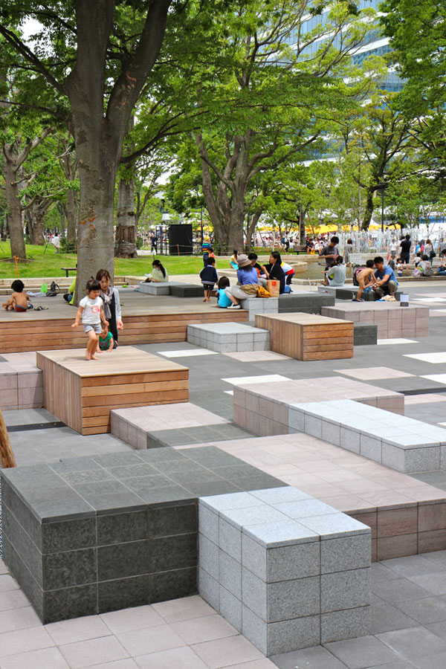

Slide 36
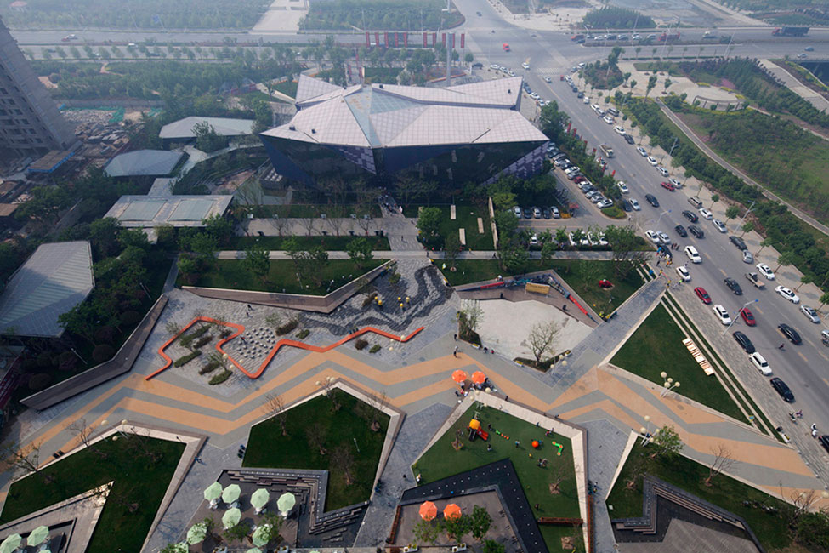
Zhengzhou Vanke Central Plaza
http://landezine.com/index.php/2015/07/zhengzhou-vanke-central-plaza-by-locus-associates/

Slide 37
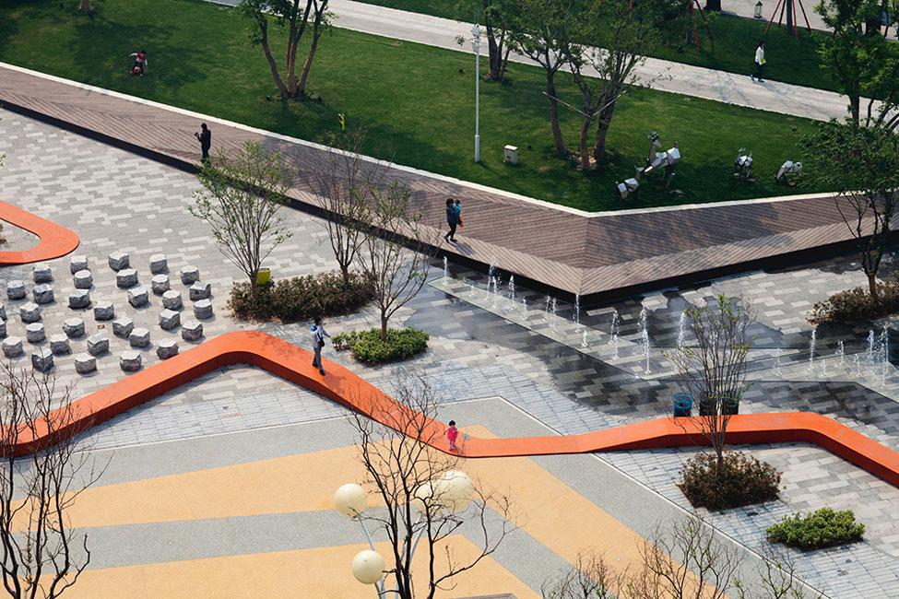

Slide 38
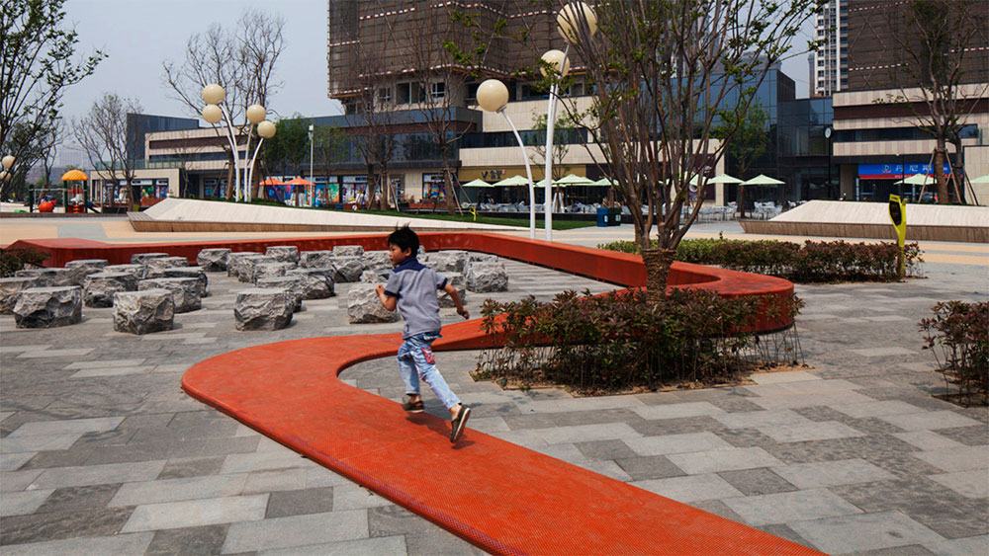

Slide 39
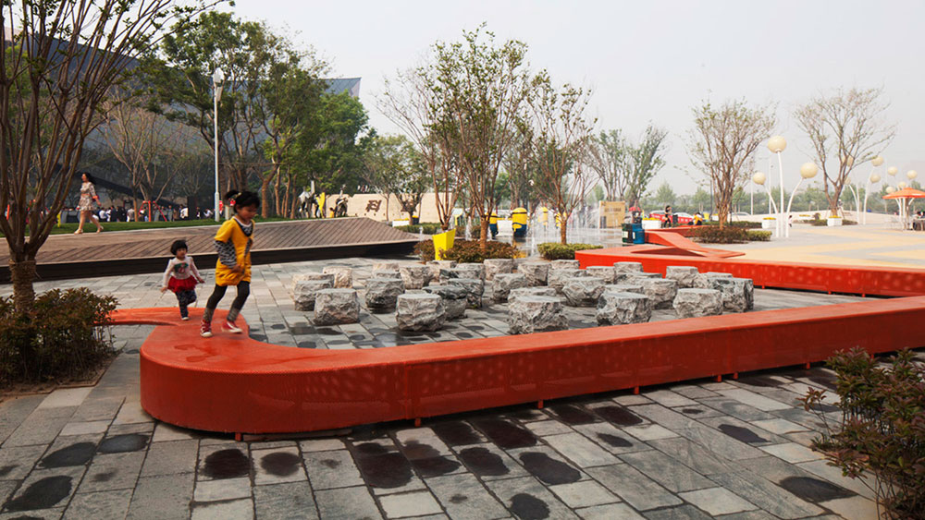

Slide 40
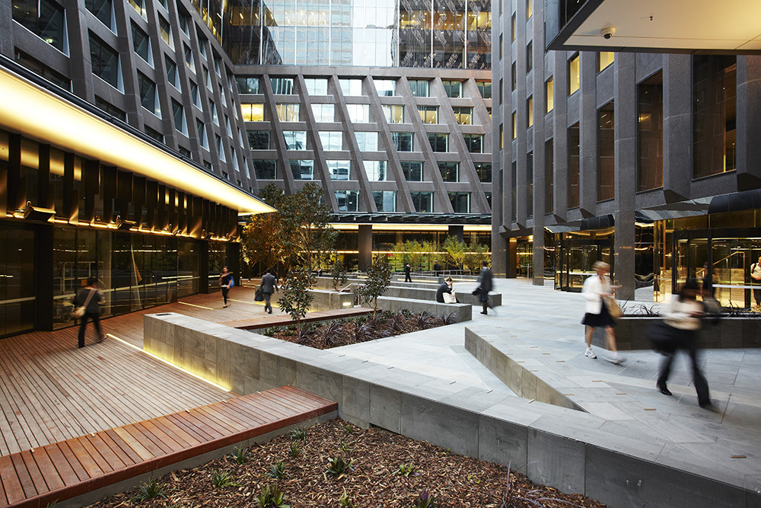
St James Plaza
https://www.archdaily.com/413013/st-james-plaza-aspect-studios

Slide 45
Midtown plaza

Slide 48
Archipelago Courtyard
http://landezine.com/index.php/2017/07/archipelago-courtyard-by-terrain-nyc/

Slide 50
Waller park
http://landezine.com/index.php/2020/03/waller-park-by-msla/

